Slide 1




CSTU CHATGPT TEAM 2
CSTU CHATGPT TEAM 2
FINAL PRESENTATION
8/23/2023
Joyce Cheng
Phil Pyo
Lam Dao
Sushil K Sharma
Alok Gupta
Fang Wang
Final Presentation 8/23/2023
Notes:
Phil: Loads slides and advances them. Introduces next speaker/topic.

Slide 2
TODAY’S PRESENTATION
Product Introduction
Technical Architecture
Database Design
Underlying Technology
Streamlit
OpenAI LLM
PineCone
Product Workflow
Product Demonstration
Lessons Learned
Areas for Improvement
Team Retrospective
Notes:
Joyce (or Phil): Covers presentation agenda

Slide 3
SOFTWARE PROJECT STATEMENT
“Introducing our university chatbot CSTUGPT, available in 6 weeks, a smart and friendly virtual assistant designed to improve student engagement, streamline administrative tasks, and provide personalized information. From answering FAQs to offering real-time updates, course registration, and academic advising, our chatbot enhances the university experience with convenient, efficient, and personalized support.”
Notes:
Joyce to present

Slide 4
SOFTWARE PROJECT STATEMENT
It is a glimpse into the CSTU’s cutting-edge approach to education, and underscores the school’s commitment to staying at the forefront of technology education, ensuring that we deliver the latest techniques and teachings to our students.
So, get ready to witness how this brilliant chatbot idea not only makes the school website shine but also perfectly reflects CSTU’s passion for “Science and Technology”.

Slide 5






TECHNICAL ARCHITECTURE
Cloud Deployment
Backend (Python)
Prospect/
Student,
Web UI
Embeddings
OpenAI API
Professor/
Admin
Vector Database
Database
Notes:
Sushil: to present
Describe the underlying technology stack, including the use of LLM and other related technology.
b) Outline the system architecture and its components, highlighting any innovative or unique features.

Slide 6
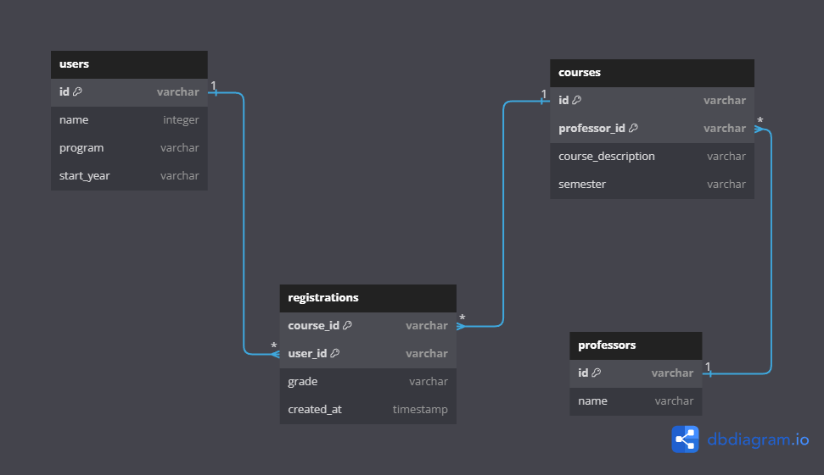
DATABASE DESIGN
Notes:
Sushil: to present

Slide 7

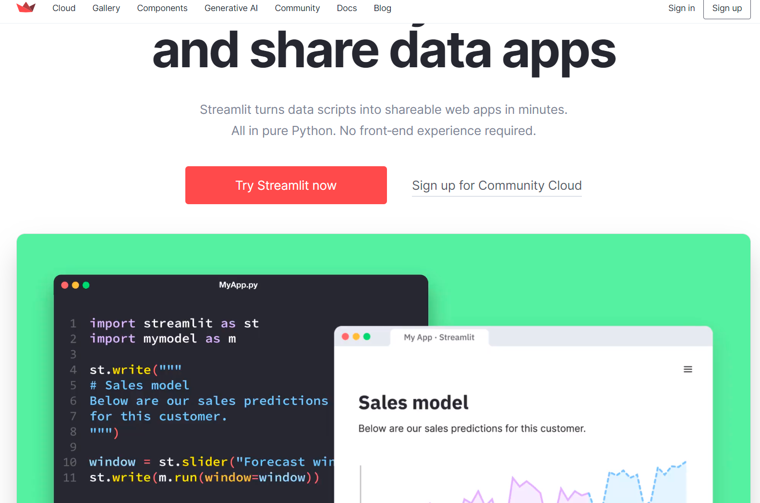
Underlying Technology - Streamlit
Faster Way to build and Share Data Apps
Comes as Python Library
pip install streamlit
Integration with github
Quickly deploy app at streamlit.io
Comes with lots of components e.g. chat
Works well with python libraries e.g. pandas
Notes:
Sushil: to present

Slide 8
System Architecture
High-level diagram of the system architecture
Key Components:
+ Frontend: Streamlit as a user interface for the chatbot
+ Backend: Python application and OpenAI GPT
+ Knowledge Base: Pinecone as a repository of information
Notes:
?? Presenting seems like we covered already in the diagram slide 4. Suggest we remove this slide. “Hiding” slide for now. (Phil)

Slide 9
Underlying Technology
1) Large Language Model (LLM):
Model Details: OpenAI gpt-3.5-turbo-0613 & text-embedding-ada-002
Core Functionality:
User Interaction
Language Understanding
Generating Responses including function call
Conversational Flow
Personalization
This model serves as the central intelligence in chatBots, enabling dynamic and personalized interaction with users.
Notes:
Fang: to present
LLM serves as the core intelligence behind the ChatBot's ability to understand natural language inputs, generate contextually relevant responses, maintain conversational context, and even generate content for emails. It empowers (enhance the conversation capabilities and responses of) the ChatBot to provide a more human-like and engaging conversational experience for users. Here's how LLM is utilized:
User Interaction: When a user interacts with the ChatBot through the Streamlit app by entering questions or messages, these inputs are sent to the OpenAI API for processing.
Language Understanding: The OpenAI GPT-3.5 model, which is an LLM, is trained on a massive amount of text data and can understand and interpret natural language inputs effectively. It understands the context, semantics, and nuances of the user's messages.
Generating Responses: The primary function of the LLM is to generate responses based on the user inputs. It generates text that is contextually relevant and aims to provide meaningful answers, explanations, or information based on the queries it receives.
Conversational Flow: The LLM helps maintain the conversational flow by understanding previous messages in the chat history and crafting responses that fit within the ongoing conversation. This enables the ChatBot to provide coherent and contextually appropriate responses.
Personalization: The LLM can use the information provided by the user, such as their name or other context, to generate personalized responses. This creates a more engaging and user-centric interaction.
Generating Email Content: The LLM is also used to generate content for emails, such as registration confirmation messages. It can craft well-structured and relevant content to send to users' email addresses.
Temperature Parameter: The project code includes a "temperature" parameter when calling the LLM, which determines the randomness of the generated responses. A higher temperature value increases randomness, while a lower value makes the responses more deterministic and focused.

Slide 10
Underlying Technology
2) OpenAI API
Serving as the backbone of the ChatBot, enabling the generation of responses and embeddings:
Generating responses:
- Conversation history
- Parameters
Function call: registration function for recording user information and sending a confirmation email
Generating embeddings: text-embedding-ada-002 model
Notes:
Fang: to present
The OpenAI API serves as the backbone of the ChatBot’s, plays a crucial role by enabling the generation of responses and embeddings, which are essential for creating meaningful and interactive conversations. It enables the ChatBot to understand user queries, generate coherent responses, and create meaningful embeddings for efficient information retrieval to provide human-like interactions and enhance the overall user experience.
Here's how the OpenAI API is used for these purposes:
Generating Responses: The OpenAI API is utilized to generate responses to the ChatBot. When a user inputs a message or query, it's sent to the OpenAI API for processing. The API employs advanced language models, such as GPT-3, to analyze the input and generate relevant and contextually appropriate responses. These responses can be in the form of textual messages that the ChatBot can provide to users, mimicking natural language conversations. The API offers control over the response generation process through parameters like "temperature" and "max tokens." Temperature controls the randomness of the generated responses, allowing the ChatBot to produce more diverse and creative outputs. Max tokens restricts the length of the generated response to a specified number of tokens, preventing excessively lengthy replies.
Generating Embeddings: Embeddings are numerical representations of text that capture its semantic meaning. Embeddings play a critical role in various natural language processing tasks, including information retrieval and similarity analysis. In the ChatBot project, embeddings are used to represent the content of documents and user queries. The OpenAI API provides an "Embedding" endpoint that allows developers to create embeddings for input text. These embeddings are compact numerical vectors that encode the underlying meaning of the text. Embeddings are useful for various tasks, including comparing the similarity between documents, clustering similar documents, and enhancing the retrieval of relevant information from a knowledge base.

Slide 11
Underlying Technology
3) Pinecone – A knowledge base for chatbot
Pinecone is a cloud-based vector database (KBaaS platform) used to store, index, query, retrieve variety of multi-dimensional vector data including text, image, audio and code with API Integration and different real-time search methods:
Full-text search
Phrase search
Regex search
Boolean search
Nearest neighbors search
Vector search
Benefits:
+ Scalability
+ Reliability
+ Simplicity
+ Performance
Notes:
Lam: to present
+Pinecone is a cloud-based vector database and and indexing system (KBaaS platform) with fully managed service that makes it easy to store, index, query/retrieve, and search for variety of multi-dimensional & dense vector embedding data including text, image, audio and code. Pinecone can handle high-dimensional vector data efficiently, which is challenging for traditional ones.
+ Pinecone offers APIs that allow you to easily integrate it into your applications
+Pinecone can be used to query and search for data in a variety of ways, including: Full-text search, Phrase search, Regular expression search, Boolean search, Nearest neighbors search (similarity search), which can be done by calculating the similarity between the documents and then finding the documents with the highest similarity scores by various metrics such as cosine similarity, Vector search: documents to be embedded in vectors.
+Pinecone can also be used to generate text, translate languages, and answer questions.
+Here are some of the benefits of using Pinecone:
Scalability: Pinecone is a fully managed service that is scalable and reliable, suitable for large datasets and high query loads.
Reliability: Pinecone is a reliable service that is backed by Google Cloud. This means that your data is safe and secure, and you can be confident that it will be available when you need it.
Simplicity: Pinecone is easy to use and can be integrated with a variety of other tools and services. You can easily add or remove data as needed.
Performance: Pinecone can handle large volumes of data, optimize storage and indexing strategies for vector data, ensuring quick retrieval times.
This makes it a great choice for applications that require high throughput and low latency.

Slide 12
Underlying Technology
3) Pinecone – A knowledge base for chatbot
Creating index and storing numerical vectors generated from document chunks by OpenAI embedding model into knowledge base.
Enriching knowledge base: Pinecone's indexing capabilities enable us to continuously enrich its knowledge base by adding new vector data.
Performing a comparison and similarity search in the knowledge base for generated embedding of user input.
Retrieving most relevant information by extracting the corresponding metadata from these vectors, including the content of the knowledge base entries.
Notes:
Lam: to present
Pinecone plays a vital role in the ChatBot project by enabling efficient vector storage, indexing, search and retrieval, which is essential for providing accurate and contextually relevant response information to users.
Creating index and storing numerical vectors generated from document chunks by OpenAI embedding model into knowledge base: In the ChatBot project, embeddings of textual data, such as user queries and knowledge base content, are used as vectors. These embeddings capture the semantic meaning of the text and are used to represent the content in a high-dimensional space. Numerical vectors (data points) are organized and indexed in Pinecone database (knowledge base). Pinecone index is a data structure optimized for efficient (fast and accurate) similarity search and retrieval.
Knowledge Base Enrichment: Pinecone's indexing capabilities also enable the ChatBot to continuously enrich its knowledge base. New documents or pieces of information can be added to the index as new vectors. This means that as the ChatBot interacts with users and learns from their queries, it can incorporate new knowledge and adapt its responses over time
Performing a comparison and similarity search in the knowledge base for generated embedding of user input: When a user inputs a query, the ChatBot generates an embedding for the query text using the OpenAI embedding model. This embedding represents the user's intent or question. The ChatBot then utilizes Pinecone's indexing capabilities to perform a similarity search to identify the similar information.
Retrieving most relevant information by extracting the corresponding metadata from these vectors, including the content of the knowledge base entries .

Slide 13
Underlying Technology
3) Pinecone – A knowledge base for chatbot
Key steps:
Preparing documents: CSTU webpage and catalogue => cstu-kb, cstu-qa
Installing and importing Pinecone-related Python packages
Getting and setting the PINECONE API KEY (OPEN AI API KEY)
Selecting embedding model
Chunking and embedding document text to chunk vectors
Initializing Pinecone index
Upserting or deleting vectors from Knowledge Base
Checking the database status
Querying the Pinecone index to retrieve relevant knowledge base entries (including metadata) based on the generated embedding of user input
Notes:
Lam: to present
Summary of coding steps:
Prepare knowledge documents: cstu-kb, cstu-qa, CSTU webpage and catalogue
Installing and importing Python pakages: openai, python-dotenv, pinecone-client, and PyPDF2 => PdfReader, pinecone
Getting and setting the PINECONE_API_KEY
Selecting embedding model "text-embedding-ada-002"
Chunking and embedding document text to vectors
Initializing Pinecone index
Upserting or deleting vectors from Knowledge Base: upsert(cstu_file, index_name, name_space, cstu_id, chunk_size, stride):The mls_upsert function is defined to upsert chunks of text from a PDF document into the Pinecone index. It iterates through the document in chunks, creates embeddings for each chunk using the specified embed_model, and then upserts the embeddings and corresponding metadata into the Pinecone index.
Checking index status: index.describe_index_stats()
Querying the Pinecone index to retrieve relevant knowledge base entries (including metadata) based on the generated embedding of user input
kb_res = index.query(res['data'][0]['embedding'], top_k=1, include_metadata=True, namespace='cstu')
If the include_metadata parameter is set to True, the query method will only return the id, score, and metadata for each document. The vector for each document will not be returned

Slide 14
Underlying Technology
4) SendGrid
Sending registration confirmation email when a student registers for a course.
Notes:
Lam: to present
SendGrid is a cloud-based email delivery and management service that provides developers with tools for sending emails. It's designed to simplify the process of sending emails, managing email campaigns, and ensuring that emails are delivered reliably to recipients' inboxes. SendGrid offers various features and capabilities.
SendGrid offers a powerful API that allows developers to programmatically send emails, enables you to incorporate email functionality directly into applications.

Slide 15
Workflow
User Input: could be a question, a query, or a request for information.
API Call to OpenAI for Embedding: generating an embedding for the user's input
Embedding Comparison with Knowledge Base: performing a similarity search for generated embedding of user input in the knowledge base
Retrieval of Relevant Information: extracts the corresponding information (metadata) from these vectors, including the content of the knowledge base entries
Response Generation: Generating a response to the user's query based on the retrieved relevant information, initial system guide and context history.
Display Response: Displaying answers to the user through the web user interface
Notes:
Joyce: to present
User Input: The interaction begins when a user provides an input to the ChatBot. This input could be a question, a query, or a request for information. The user submits their input through the user interface of the ChatBot application.
API Call to OpenAI for Embedding: Once the user input is received, the ChatBot makes an API call to the OpenAI API to generate an embedding for the user's input. The embedding captures the semantic meaning of the text and represents it as a numerical vector.
Embedding Comparison with Knowledge Base: The ChatBot takes the generated embedding for the user input and performs a similarity search in the knowledge base. It uses Pinecone's indexing capabilities to retrieve vectors from the knowledge base that are most similar to the user's query embedding. These retrieved vectors correspond to knowledge base entries that are contextually relevant to the user's query.
Retrieval of Relevant Information: Pinecone returns a list of vectors representing knowledge base entries that are contextually relevant to the user's query. The ChatBot extracts the corresponding information from these vectors, which typically include the content of the knowledge base entries.
Response Generation: Based on the retrieved relevant information, the ChatBot generates a response to the user's query. It may use the content from the knowledge base vectors as part of the response or craft a response based on a combination of the knowledge base content and other predefined responses.
Display Response: The generated response is then displayed to the user through the user interface of the ChatBot application. The user sees the response on their screen, allowing them to understand and engage with the information provided by the ChatBot.
User Interaction Continues: The user may continue the interaction by providing additional input or queries. The ChatBot repeats the process of generating embeddings, performing similarity searches, and generating responses for each new user input.
Throughout this workflow, the integration of OpenAI and Pinecone plays a crucial role. OpenAI's API generates embeddings that capture the meaning of user input, allowing the ChatBot to understand the user's intent. Pinecone's indexing capabilities ensure efficient and accurate retrieval of relevant information from the knowledge base, enhancing the ChatBot's ability to provide contextually relevant responses.

Slide 16
CHATBOT DEMO
Notes:
Sushil: to demo
Showcase the chatbot in action, demonstrating its core capabilities with real-world scenarios.
b) Highlight any specific challenges face during development and how they were addressed.

Slide 17
LESSONS LEARNED
Reflection:
Set up workflow early in process - GitHub based
Not everyone could spin up on this quickly
Successes & Obstacles
Members contributed where they were strong and stretched where they weren’t
This was a balance between productivity and skill building
Challenges with conflicting schedules
We had limited synchronous work which limited knowledge transfer
Project Scope Changes
We were learning what was possible as we were implementing
This is how very innovative teams must work
Notes:
Alok: to present
Reflect on the development process and agile methodology used during the project.
Discuss the successes and achievements, as well as the obstacles encountered and how they were overcome.
Mention any changes in project scope or adjustments made during the development cycle.

Slide 18
AREAS FOR IMPROVEMENT
Performance / Functionality Enhancements
Security testing and safeguarding of personal private information
Insights from User Testing
The chatbot struggled to remember user context during longer conversation.
Robust QA and security testing needed prior to deployment
Future Development
Natural language based login and security
Chat based career advisor (pulls from student record)
Job board (input by administrator)
Resume builder (customize resume to specific jobs on job board)
Access control
Marketing engine (collect data, generate emails from referrals, etc)
Notes:
Alok: to present
Identify aspects of the chatbot's performance or functionality that could be enhanced in the future.
Share insights gained from user feedback or testing that could lead to improvements.
Discuss any potential enhancements to the product or opportunities for further development.

Slide 19
TEAM RETROSPECTIVE
“Incredibly learning experience on the capabilities of OpenAI LLM, prompt engineering, API calls, functions, utilization of vector databases and the power of teamwork to create a working ChatBot.” - Phil
“I learned so much about how to properly use LLM APIs. I have been programing various other special purpose bots to do my bidding!” -Alok
"Our teamwork rocked, and we soaked up diverse learning experiences. Super excited about nailing the on-time delivery of our cstuGPT app!" -Fang
“I'm thrilled to have taken this course and been a part of this team. Not only have I learned a lot, but it's also been incredibly practical. I can now apply these techniques to develop a chatbot for my own website.” – Joyce
Thera are so many areas for improving the quality and functionality of the product but what the team achieved is so great. I learned so much knowledge and practice many skills through out the class and my team. A wonderful memory! - Lam Dao
Notes:
Phil, Alok, Fang and any other team members: Presents their own quote.

Slide 20
THANKS

Slide 21
Backup Slides

Slide 22
FINAL PRESENTATION OUTLINE
Product Introduction: a) Provide an overview of the chatbot's purpose, target audience, and main functionalities. b) Explain the problem the chatbot aims to solve and its potential benefits.
ChatBot Solution Architecture: a) Describe the underlying technology stack, including the use of LLM and other related technology. b) Outline the system architecture and its components, highlighting any innovative or unique features.
Product Demonstration: a) Showcase the chatbot in action, demonstrating its core capabilities with real-world scenarios. b) Highlight any specific challenges face during development and how they were addressed.
Lessons Learned: a) Reflect on the development process and agile methodology used during the project. b) Discuss the successes and achievements, as well as the obstacles encountered and how they were overcome. c) Mention any changes in project scope or adjustments made during the development cycle.
Areas for Improvement: a) Identify aspects of the chatbot's performance or functionality that could be enhanced in the future. b) Share insights gained from user feedback or testing that could lead to improvements. c) Discuss any potential enhancements to the product or opportunities for further development.

Slide 23





TEAM 2
Joyce Cheng
Phil Pyo
Lam Dao
Sushil Sharma
Alok Gupta
Fang Wang
Collaboration
Zoom meetings
Email
Google Chat group
Google docs
github

Slide 24
PROCESS
Notes: Phil – I reformatted but can also revise based on Agile and including scrum and development process
Team Formation
Vision / Planning Meeting
User Story Template
Actors / Users
User Stories
Retrospective

Slide 25
TEMPLATE
Notes: Phil – From existing slides but suggest we remove or brevity
As a (User / Actor)
I want to... (Task)
so that... (Value/Goal)

Slide 26
RETROSPECTIVE (2/2)- OPPORTUNITIES FOR IMPROVEMENT
Notes: Phil – From existing slides but suggest we remove or brevity
Making
Making the project vision more clear based on past classes (constraints)
Limiting
Limiting scope to fit in 8 weeks

Slide 27
USER STORIES & MVP
As a User / Actor | I want to... (Task) | So that... (Value/Goal) | MVP | Owner | Coding done | Pull request | Merged
Academic Administrator | Input grade information | Student can get secure information on his or her performance and progress This information will be held securely and only accessible to people admins and the student who earned the grades for privacy. | x | Alok
Academic Administrator | Evaluate Applications | School can see whom to accept
Academic Administrator | Input job prospects | Job board will be as current as possible so students are aware of the freshest job prospects
All Adminstrators | Set up password for account and permission | Grant access for various tasks and create a secure environment where privacy is maintained. | x
Applicant / Prospect | upload application | Prospective student can apply for program
CSTU Chat User | I can interect with the CSTUGPT via chat using english language in a web browser | I can comminicate and get information in natural language and feel like CSTU values my time. | x | Alok
Future Student | Access scholarship information | Lower bariers to attendance. | x
Professor/Faculty | Input course description | Students can inquire about information and get up to date information in an friendly and natual way | x | Fang
Student | Inquire about courses in natural language | So that I can learn more about the courses in a friendly and natural way | x
Student | Student can register for a course using chat | Student can be registered easily using the chat interace | x | Fang

Slide 28
USER STORIES & MVP (COND’T)
As a User / Actor | I want to... (Task) | So that... (Value/Goal) | MVP | Owner | Coding done | Pull request | Merged
CSTU Chat User | Send registration confirmation via email to the user | Send registration confirmation via email to the user |  | Fang
CSTU Chat User | Store the registration information in a database | the information can be retrieved later on | x | Sushil
Student | Student can upload a plain language resume describing experience in a verbose manner | This will be the basis for automatic resume generation
Student | Use GPT to generate Resume and Coverleter given student's plain language resume for job on job board. | Student can do a quick and effective application
Student | anonymously input course evaluation | Give anonymous feedback to professors and administrators. | x | sushil
Student | Set up password for account | Gives student access to sensitive information and protects student's privacy. | x
Student | Get personalized career counseling through chatbot | Students can inquire and see which classes to take give background goals and classes already taken. | x | Alok
System Administrator | Feed new documents to database | Keep corpus fresh | x | sushil

Slide 29
RETROSPECTIVE (1/2)- WHAT WENT RIGHT
Notes: Phil – From existing slides but suggest we remove or brevity
Fleshed out technologies and packages to make the project happen
Team was very focused on the deliverables for session1 (User Stories and Retrospective)
Team defined / agreed upon the MVP tasks out of the user stories

Slide 30

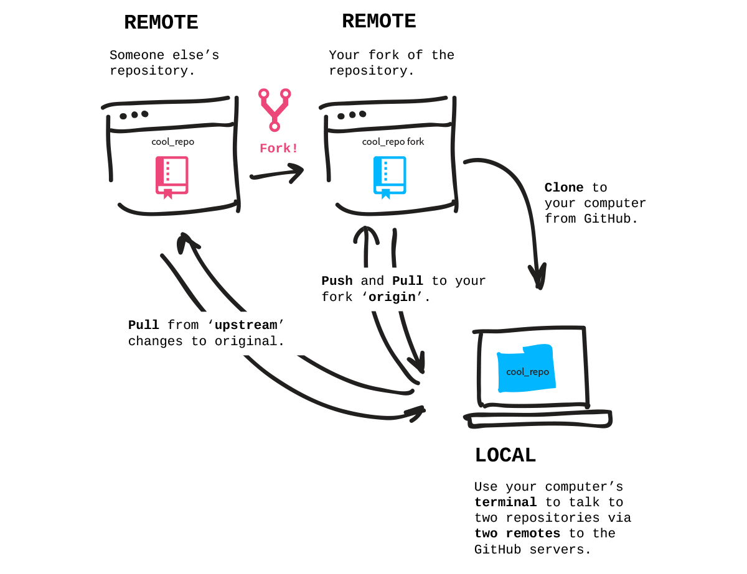
CODE COMMIT WORKFLOW
Notes: Phil – can clean up more but let’s check for what we used in final demo.

Slide 31


DEPLOYMENT OPTIONS
Notes: Phil – Let me know if we like to keep this slide
STREAMLET COMMUNITY CLOUD
AWS EC2

Slide 32
RETROSPECTIVE
Notes: Phil – Will add key points based on our team’s retrospective on Saturday’s demo

